Slide 1
APT 3010
NEURAL NETWORKS.

Slide 2
Objectives
To Provide a Background Considering:
What is a neural network?
Historical background.
Why use neural networks?
Neural networks versus conventional computers - a comparison

Slide 3
Introduction To Neural Networks.
Neural networks are parallel computing devices, which are basically an attempt to make a computer model of the brain.
Artificial Neural Network ANN is an efficient computing system whose central theme is borrowed from the analogy of biological neural networks.

Slide 4
Introduction To Neural Networks.
ANNs are also named as “artificial neural systems,” or “parallel distributed processing systems,” or “connectionist systems.”
ANN acquires a large collection of units that are interconnected in some pattern to allow communication between the units.
These units, also referred to as nodes or neurons, are simple processors which operate in parallel.

Slide 5
Introduction To Neural Networks.
Every neuron is connected with other neuron through a connection link.
Each connection link is associated with a weight that has information about the input signal.
This is the most useful information for neurons to solve a particular problem because the weight usually excites or inhibits the signal that is being communicated.
Each neuron has an internal state, which is called an activation signal. Output signals, which are produced after combining the input signals and activation rule, may be sent to other units.

Slide 6
A Brief History of ANN
The history of ANN can be divided into the following three eras −
ANN during 1940s to 1960s
Some key developments of this era are as follows
1943 − It has been assumed that the concept of neural network started with the work of physiologist, Warren McCulloch, and mathematician, Walter Pitts, when in 1943 they modeled a simple neural network using electrical circuits in order to describe how neurons in the brain might work.

Slide 7
A Brief History of ANN
1949 − Donald Hebb’s book, The Organization of Behavior, put forth the fact that repeated activation of one neuron by another increases its strength each time they are used.
1956 − An associative memory network was introduced by Taylor.
1958 − A learning method for McCulloch and Pitts neuron model named Perceptron was invented by Rosenblatt.
1960 − Bernard Widrow and Marcian Hoff developed models called "ADALINE" and “MADALINE.”

Slide 8
ANN during 1960s to 1980s
Some key developments of this era are as follows −
1961 − Rosenblatt made an unsuccessful attempt but proposed the “backpropagation” scheme for multilayer networks.
1964 − Taylor constructed a winner-take-all circuit with inhibitions among output units.
1969 − Multilayer perceptron MLP was invented by Minsky and Papert.
1971 − Kohonen developed Associative memories.
1976 − Stephen Grossberg and Gail Carpenter developed Adaptive resonance theory.

Slide 9
ANN from 1980s till Present
Some key developments of this era are as follows −
1982 − The major development was Hopfield’s Energy approach.
1985 − Boltzmann machine was developed by Ackley, Hinton, and Sejnowski.
1986 − Rumelhart, Hinton, and Williams introduced Generalised Delta Rule.
1988 − Kosko developed Binary Associative Memory BAM and also gave the concept of Fuzzy Logic in ANN.

Slide 10
ANN from 1980s till Present
The historical review shows that significant progress has been made in this field.
Neural network based chips are emerging and applications to complex problems are being developed.
Surely, today is a period of transition for neural network technology.

Slide 11
Defining Neural Networks.
Neural networks, also known as artificial neural networks (ANNs) or simulated neural networks (SNNs), are a subset of machine learning and are at the heart of deep learning algorithms.
Their name and structure are inspired by the human brain, mimicking the way that biological neurons signal to one another.

Slide 12
Defining Neural Networks.
Artificial neural networks (ANNs) are comprised of a node layers, containing an input layer, one or more hidden layers, and an output layer.
Each node, or artificial neuron, connects to another and has an associated weight and threshold.

Slide 13
Defining Neural Networks.
If the output of any individual node is above the specified threshold value, that node is activated, sending data to the next layer of the network.
Otherwise, no data is passed along to the next layer of the network.

Slide 14
Key Terms
Neuron: A building block of ANN. It is responsible for accepting input data, performing calculations, and producing output.
Input data: Information or data provided to the neurons.
Artificial Neural Network(ANN): A computational system inspired by the way biological neural networks in the human brain process information.

Slide 15
Key Terms
Deep Neural Network: An ANN with many layers placed between the input layer and the output layer.
Weights: The strength of the connection between two neurons. Weights determine what impact the input will have on the output.
Bias: An additional parameter used along with the sum of the product of weights and inputs to produce an output.
Activation Function: Determines the output of a neural network.

Slide 16
Biological Neuron
A nerve cell neuron is a special biological cell that processes information. According to an estimation, there are huge number of neurons, approximately 1011 with numerous interconnections, approximately 1015.

Slide 17
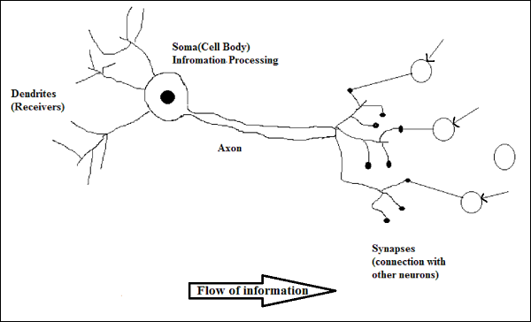
Biological Neuron.

Slide 18
Working of a Biological Neuron
As shown in the above diagram, a typical neuron consists of the following four parts with the help of which we can
explain its working −

Slide 19
Working of a Biological Neuron
Dendrites − They are tree-like branches, responsible for receiving the information from other neurons it is connected to. In other sense, we can say that they are like the ears of neuron.
Soma − It is the cell body of the neuron and is responsible for processing of information, they have received from dendrites.
Axon − It is just like a cable through which neurons send the information.
Synapses − It is the connection between the axon and other neuron dendrites.

Slide 20
ANN versus BNN
Before taking a look at the differences between Artificial Neural Network ANN and Biological Neural Network BNN, let us take a look at the similarities based on the terminology between these two.
Biological Neural Network BNNBNN | Artificial Neural Network ANNANN
Soma | Node
Dendrites | Input
Synapse | Weights or Interconnections
Axon | Output

Slide 21
ANN versus BNN
The following table shows the comparison between ANN and BNN based on some criteria mentioned.

Slide 22
ANN versus BNN
 | BNN | ANN
Processing | Massively parallel, slow but superior than ANN | Massively parallel, fast but inferior than BNN
Size | 10¹¹ neurons and 10¹⁵ interconnections | 10² to 10⁴ nodes mainlydependsonthetypeofapplicationandnetworkdesignermainlydependsonthetypeofapplicationandnetworkdesigner
Learning | They can tolerate ambiguity | Very precise, structured and formatted data is required to tolerate ambiguity
Fault tolerance | Performance degrades with even partial damage | It is capable of robust performance, hence has the potential to be fault tolerant
Storage capacity | Stores the information in the synapse | Stores the information in continuous.

Slide 23
ANN OVERVIEW.
Have you ever wondered how your brain recognizes images? No matter what or how the image looks, the brain can tell that this is an image of a cat and not a dog.
The brain relates to the best possible pattern and concludes the result.
The example below will help you understand neural networks:
Consider a scenario where you have a set of labeled images, and you have to classify the images based on if it is a dog or a cat.

Slide 24
ANN OVERVIEW.
To create a neural network that recognizes images of cats and dogs.
The network starts by processing the input.
Each image is made of pixels.
For example, the image dimensions might be 20 X 20 pixels that make 400 pixels.
Those 400 pixels would make the first layer of our neural network.

Slide 25
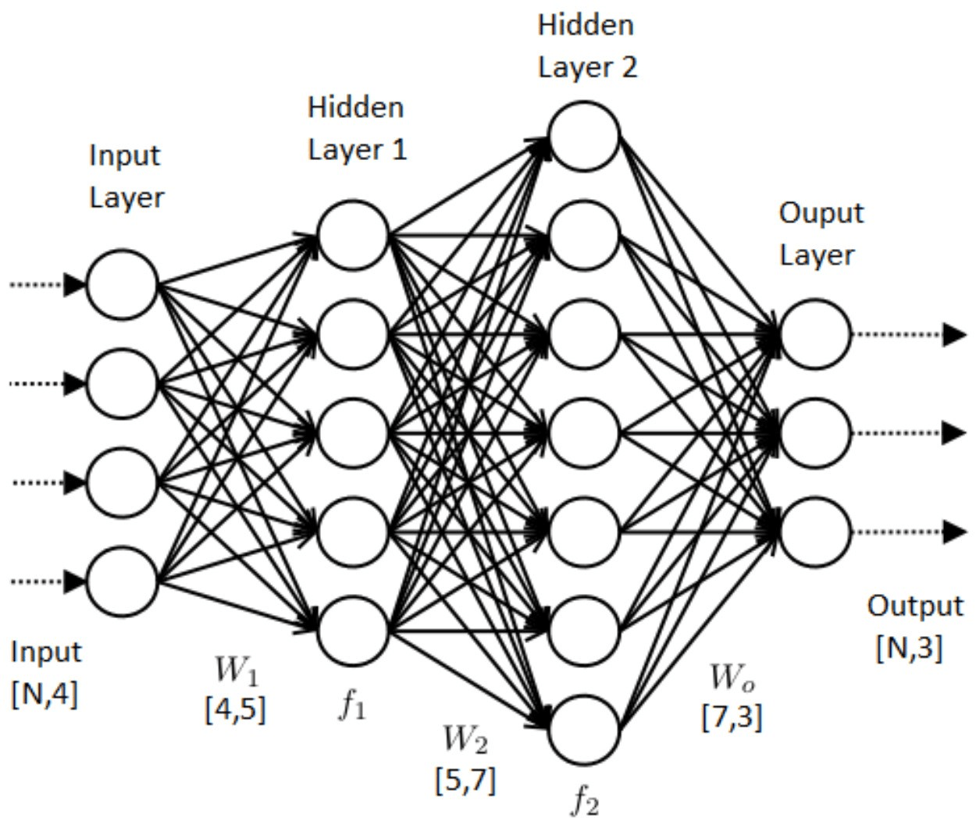
ANN OVERVIEW.

Slide 26
ANN OVERVIEW.
A neural network is made of artificial neurons that receive and process input data.
Data is passed through the input layer, the hidden layer, and the output layer.
A neural network process starts when input data is fed to it. Data is then processed via its layers to provide the desired output.
A neural network learns from structured data and exhibits the output.

Slide 27
ANN OVERVIEW.
The essential building block of a neural network is a perceptron or neuron.
It uses the supervised learning method to learn and classify data.

Slide 28
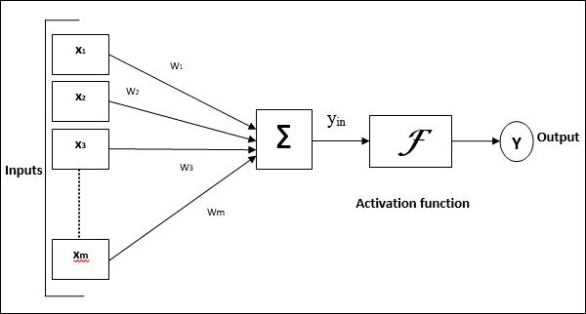
Model of Artificial Neural Network.
The following diagram represents the general model of ANN followed by its processing.

Slide 29
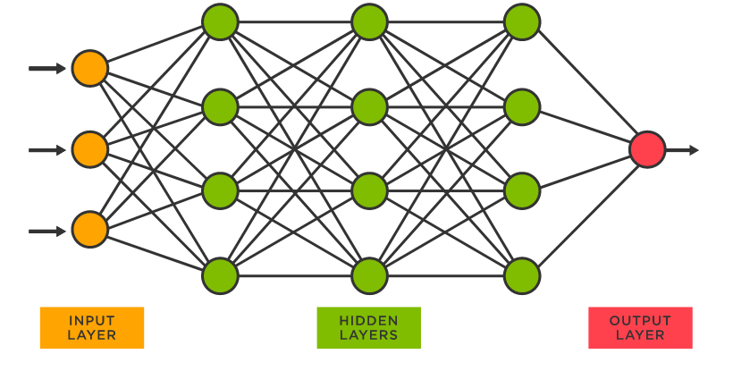
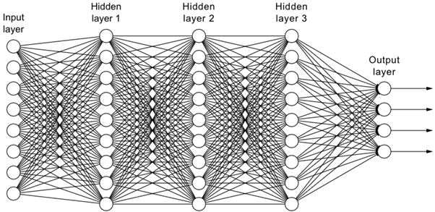
Model of Artificial Neural Network.
The following diagram represents the general model of ANN followed by its processing.

Slide 30
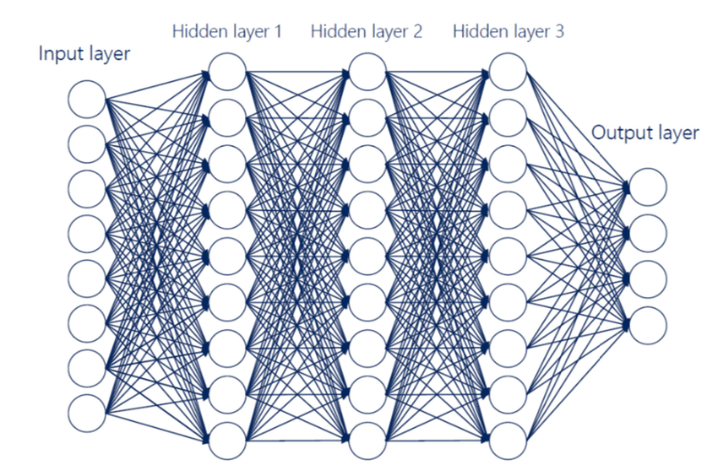
Model of Artificial Neural Network.

Slide 31
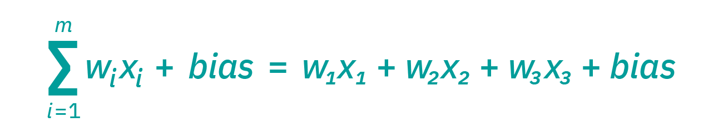
How do neural networks work?
Think of each individual node as its own linear regression model, composed of input data, weights, a bias (or threshold), and an output.
The formula would look something like this:

Slide 32
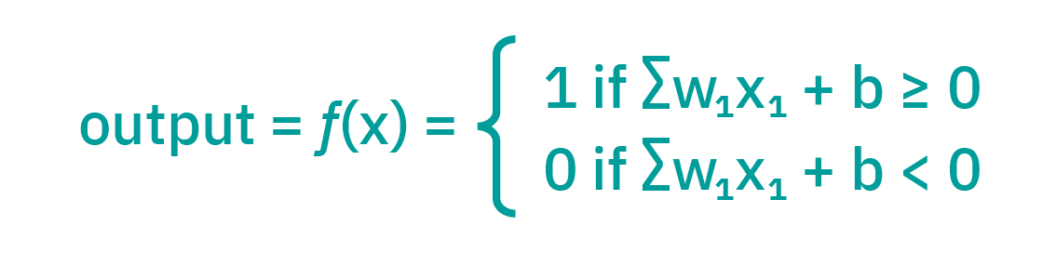
How do neural networks work?
∑wixi + bias = w1x1 + w2x2 + w3x3 + bias.
output = f(x) = 1 if ∑w1x1 + b>= 0; 0 if ∑w1x1 + b < 0

Slide 33
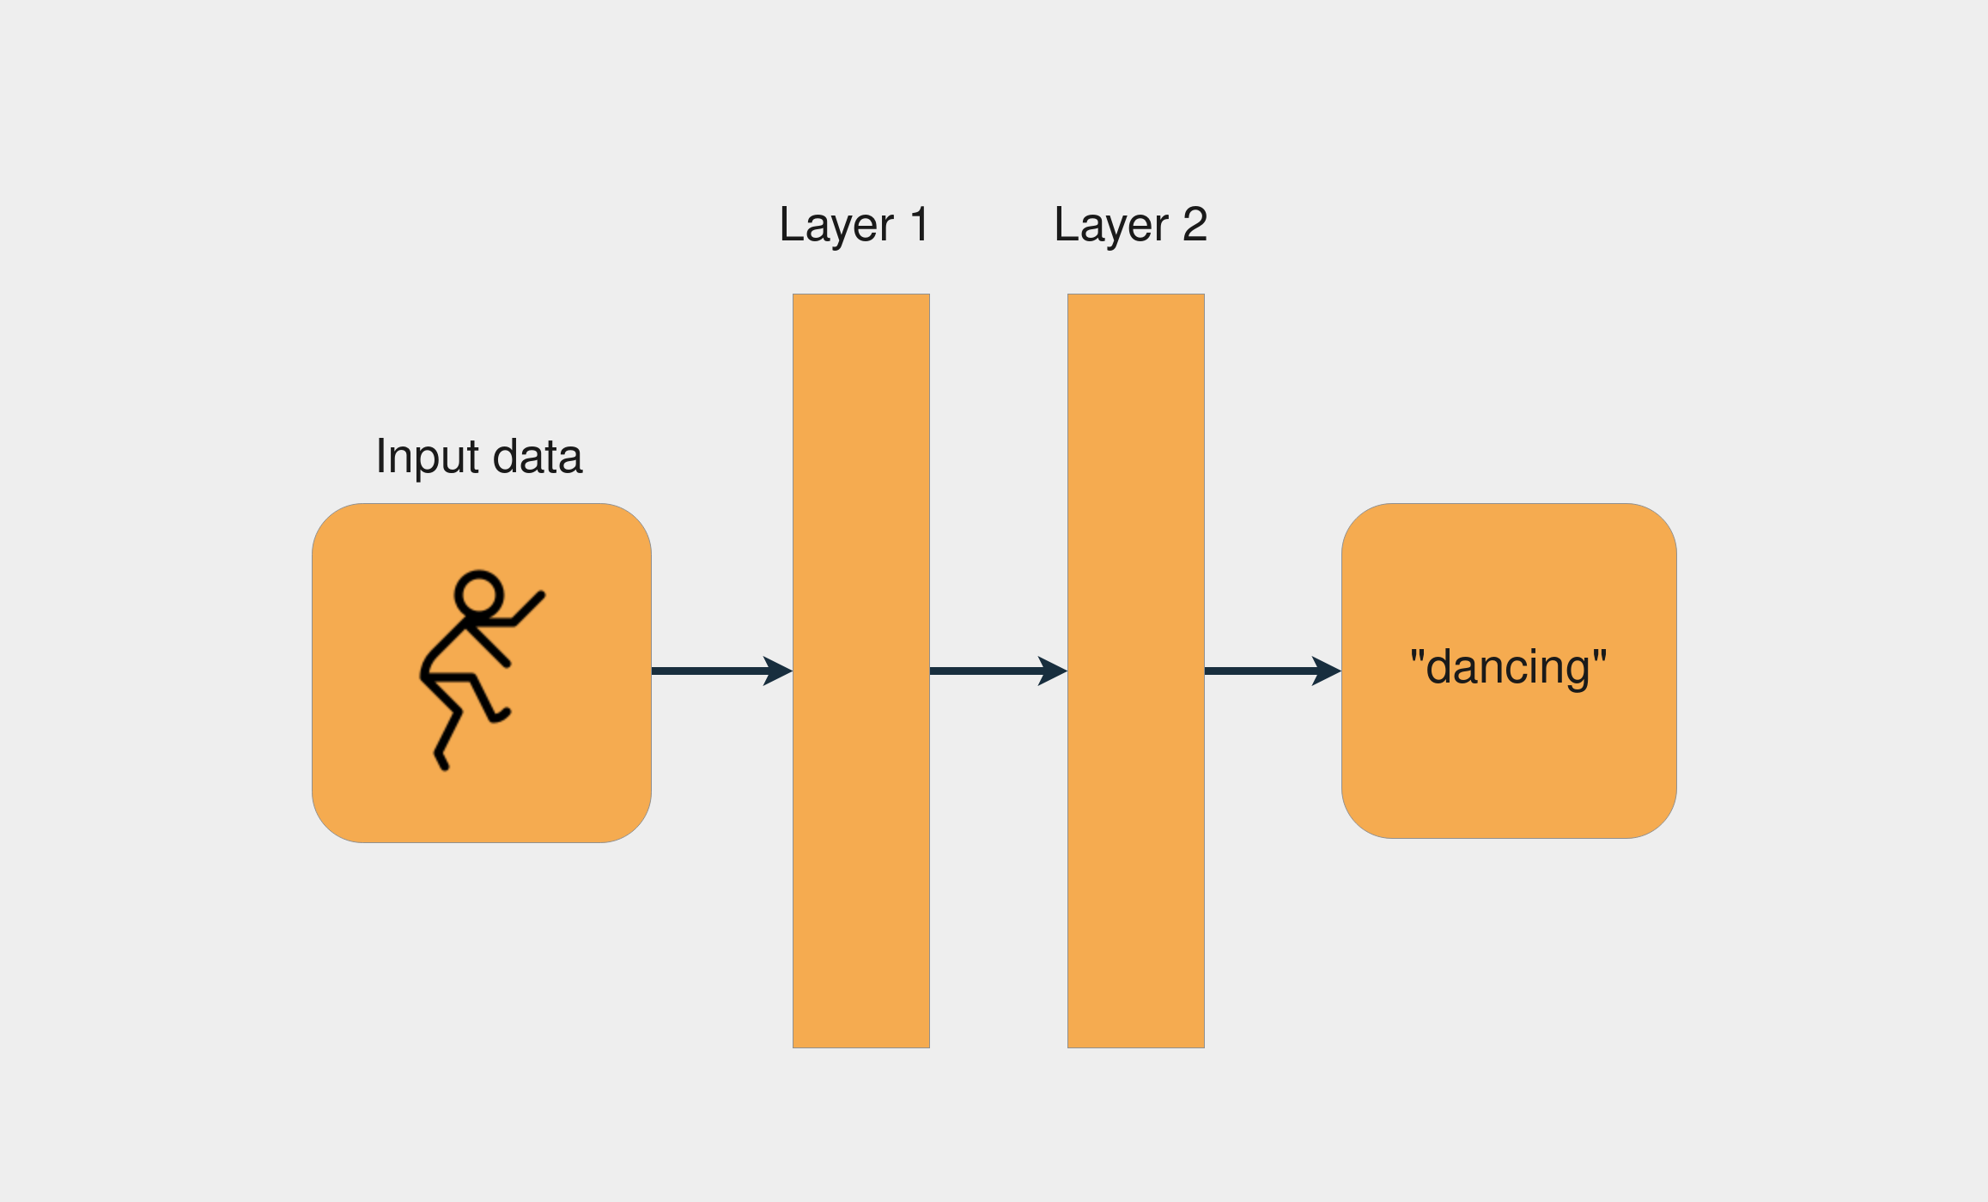
Model of Artificial Neural Network.

Slide 34
ANN VISUALIZATION TOOLS.
To demonstrate hidden layer https://alexlenail.me/NN-SVG/index.html
https://github.com/ashishpatel26/Tools-to-Design-or-Visualize-Architecture-of-Neural-Network

Slide 35
Q&A

